Slide 1







Slide 2
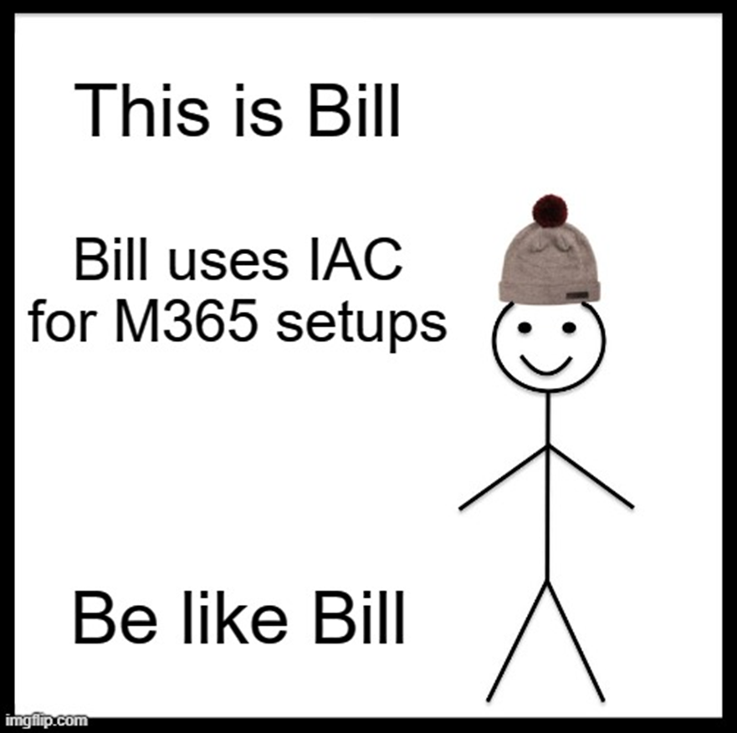
Workplace As Code: Microsoft 365 DSC
Ralph Eckhard
4 oktober 2023

Slide 3

M365 DSC
Desired state configuration for Modern Workplace
Declarative syntax
Open source, hosted on Github
Led by Microsoft, but community maintained

Slide 4
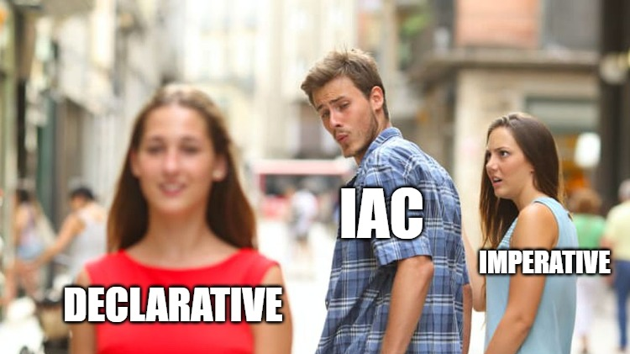

Slide 5
Infrastructure as Code
Imperative | Declarative
Explicit instructions | Describe the outcome
Basically running scripts to perform actions | The system will decided what needs to be done
The system is stupid, you are smart | The system is smart... You don’t care.

Slide 6
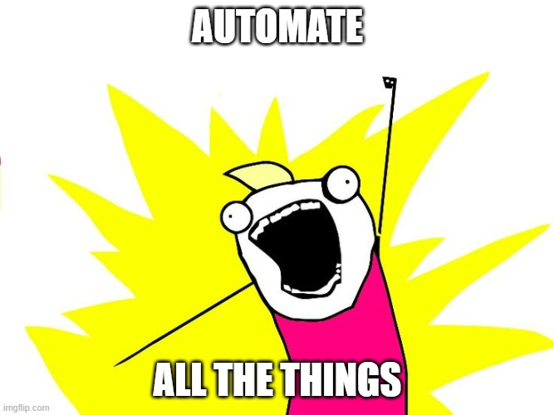
M365DSC Capabilities
Automate
Export
Synchronize
Asses
Monitor
Report

Slide 7
Getting started
Export
Get the prereqs
Prerequisites
PowerShell (see PowerShell 7 info)
Windows Terminal recommended
Install-Module Microsoft365DSC –Force
Update-M365DSCDependencies
Asses
Report
Automate
Monitor
Synchronize

Slide 8
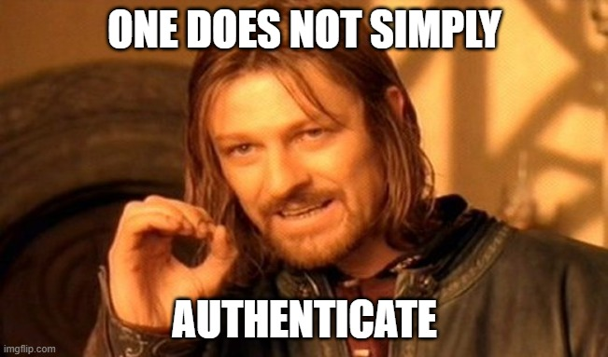
Export
Asses
Report
Automate
Monitor
Synchronize

Slide 9
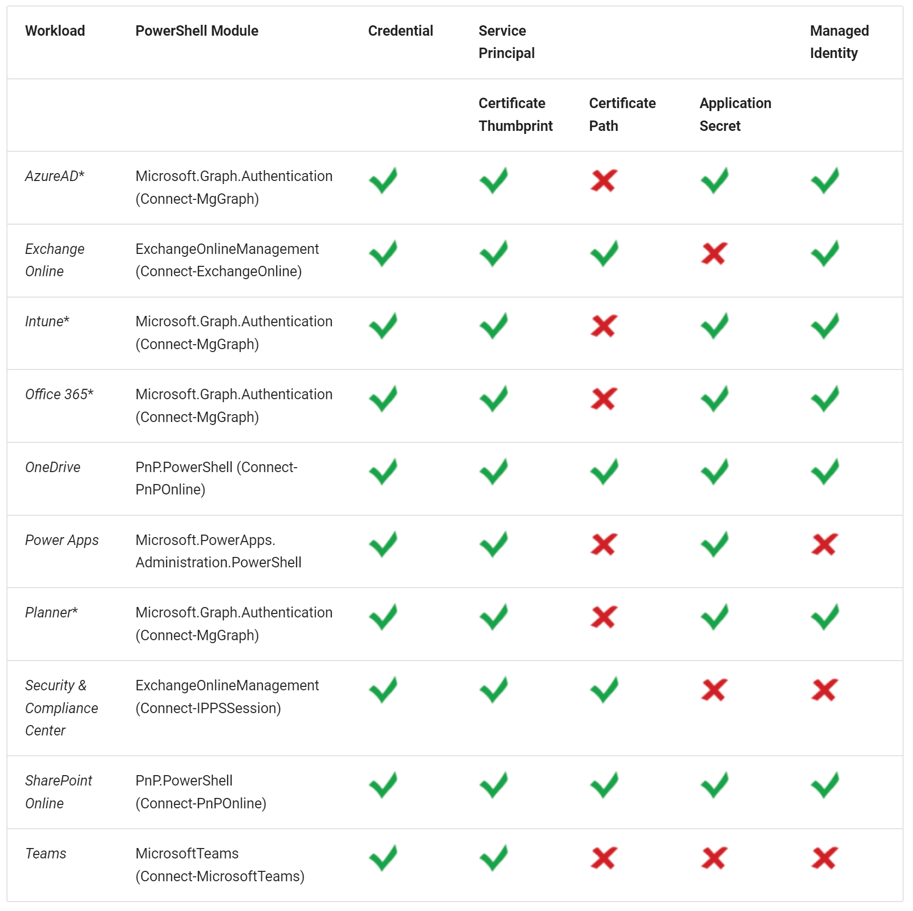
Export
Asses
Report
Automate
Monitor
Synchronize

Slide 10
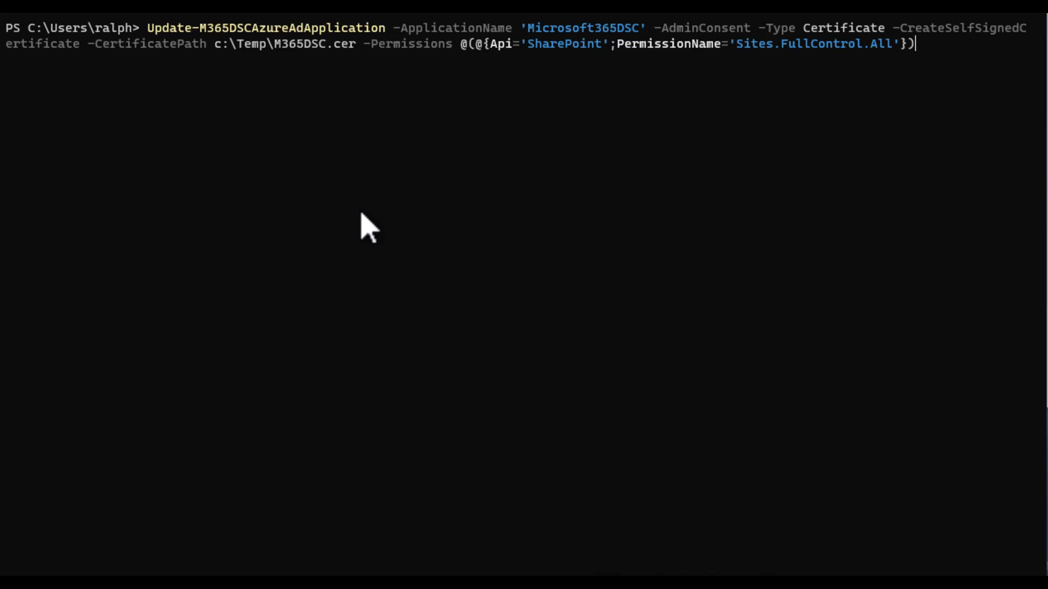
Export
Asses
Report
Automate
Monitor
Synchronize

Slide 11
Set correct permissions
Export
Update-M365DSCAzureADApplication
Azure AD Roles for App Registration
SharePoint settings for App Secret
Exchange Roles / RoleGroups
Admin Consent for API access
Asses
Report
Automate
Monitor
Synchronize

Slide 12

Exporting Config
Export
Export-M365DSCConfiguration
Use the –LaunchWebUI switch
Specify the components to export
Or use workloads
Optionally specify filename
Asses
Report
Automate
Monitor
Synchronize

Slide 13

Comparing Configurations
Export
New-M365DscDeltaReport
Specify source and destination
Outputs an HTML report
Useful for comparing two tenants
i.e. Test and Production
Asses
Report
Automate
Monitor
Synchronize

Slide 14
Creating a configuration report
Export
New-M365DscReportFromConfiguration
Specify source file
Outputs Excel or HTML
Point in time configuration reporting
Asses
Report
Automate
Monitor
Synchronize

Slide 15
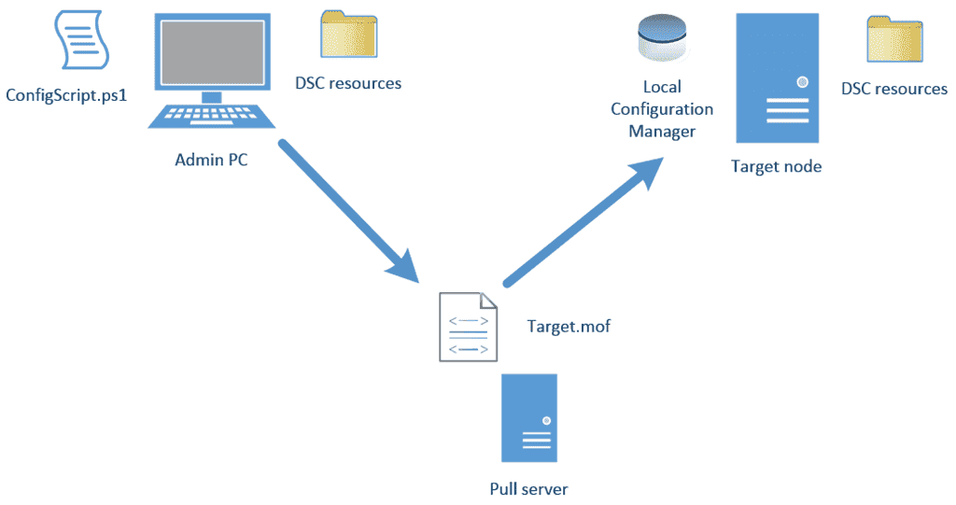
Export
Asses
Report
Automate
Monitor
Synchronize

Slide 16
Leveraging actual DSC
Export
Create a DSC Configuration
Simply run the .ps1-file from the export
Deploy the DSC Configuration
Start-DSCConfiguration
Asses
Report
Automate
Monitor
Synchronize

Slide 17
Using DevOps for Automation
Export
When changing the configuration, create a new mof
Move the mof to a server
Apply the DSC configuration
Asses
Report
Automate
Monitor
Synchronize

Slide 18

Monitoring
Export
Monitor locally using the LCM
Monitor using a pipeline in DevOps
Asses
Report
Automate
Monitor
Synchronize

Slide 19
Synchronize
Export
Basically, takes the export from one tenant to apply it to another tenant
Export-M365DSCConfiguration
Run the .ps1 file to create the mof
Think about authentication!
Start-DSCConfiguration
Asses
Report
Automate
Monitor
Synchronize

Slide 20

Q&A

Slide 21
Ralph Eckhard https://www.ralpheckhard.com https://twitter.com/ralpje https://linkedin.com/in/ralpheckhard https://github.com/ralpje

